Slide 1
Introduction to HTML

Slide 2
What is HTML?
HTML is a markup language for describing web documents (web pages).
HTML stands for Hyper Text Markup Language
A markup language is a set of markup tags
HTML documents are described by HTML tags
Each HTML tag describes different document content

Slide 3
Example 1
<html>
<body>
<h1>My First Heading</h1>
<p>My first paragraph.</p>
</body>
</html>
Explanation:

Slide 4
HTML Tags
HTML tags are keywords (tag names) surrounded by angle brackets:
<tagname>content</tagname>
HTML tags normally come in pairs like <p> and </p>
The first tag in a pair is the start tag, the second tag is the end tag
The end tag is written like the start tag, but with a slash before the tag name

Slide 5
HTML Editors
Adobe Dreamweaver
Microsoft Expression Web
CoffeeCup HTML Editor

Slide 6
First web page using Notepad
Step 1: Open Notepad
Open Notepad
Step 2: Write sample HTML codes
Example:
<html>
<body>
<h1>My First Heading</h1>
<p>My first paragraph.</p>
</body>
</html>

Slide 7
Step 3: Save the HTML Page
File -> Save as use either the .htm or the .html file extension.
Step 4: View HTML Page in Your Browser
Double-click your saved HTML file.

Slide 8
HTML Headings
<html>
<body>
<h1>This is heading 1</h1>
<h2>This is heading 2</h2>
<h3>This is heading 3</h3>
<h4>This is heading 4</h4>
<h5>This is heading 5</h5>
<h6>This is heading 6</h6>
</body>
</html>

Slide 9
HTML Paragraphs
<html>
<body>
<p>This is a paragraph.</p>
<p>This is a paragraph.</p>
<p>This is a paragraph.</p>
</body>
</html>

Slide 10
HTML Images
<html>
<body>
<img src="w3schools.jpg" alt="W3Schools.com" width="104" height="142">
</body>
</html>

Slide 11
HTML Elements
HTML elements are written with a start tag, with an end tag, with the content in between:
<tagname>content</tagname>
The HTML element is everything from the start tag to the end tag:
<p>My first paragraph.</p>
Start tag | Element content | End tag
<h1> | My First Heading | </h1>
<p> | My first paragraph. | </p>

Slide 12
Nested HTML Elements
4 HTML elements:
<html>
<body>
<h1>My First Heading</h1>
<p>My first paragraph.</p>
</body>
</html>

Slide 13
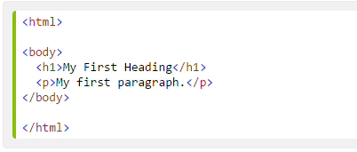
HTML Example Explained
The <html> element defines the whole document.
It has a start tag <html> and an end tag </html>.
The element content is another HTML element (the <body> element).

Slide 14

HTML Example Explained
The <body> element defines the document body.
It has a start tag <body> and an end tag </body>.
The element content is two other HTML elements (<h1> and <p>).

Slide 15

HTML Example Explained
The <h1> element defines a heading.
It has a start tag <h1> and an end tag </h1>.
The element content is: My First Heading.

Slide 16

HTML Example Explained
The <p> element defines a paragraph.
It has a start tag <p> and an end tag </p>.
The element content is: My first paragraph.

Slide 17
HTML Headings
Headings are defined with the <h1> to <h6> tags.
<h1> defines the most important heading.
<h6> defines the least important heading.

Slide 18
Example 2
<html>
<body>
<h1>This is heading 1</h1>
<h2>This is heading 2</h2>
<h3>This is heading 3</h3>
<h4>This is heading 4</h4>
<h5>This is heading 5</h5>
<h6>This is heading 6</h6>
</body>
</html>

Slide 19
HTML Horizontal Rules
<html>
<body>
<p>The hr tag defines a horizontal rule:</p>
<hr>
<p>This is a paragraph.</p>
<hr>
<p>This is a paragraph.</p>
<hr>
<p>This is a paragraph.</p>
</body>
</html>

Slide 20
HTML <head> Element
The HTML <head> element has nothing to do with HTML headings.
The HTML <head> element only contains metadata.
The HTML <head> element is placed between the <html> tag and the <body> tag

Slide 21
Example 3
<html>
<head>
<title>My First HTML</title>
<meta charset="UTF-8">
</head>
<body>
<p>The HTML head element contains meta data.</p>
<p>Meta data is data about the HTML document.</p>
</body>
</html>

Slide 22
HTML Tag Reference
Tag | Description
<html> | Defines an HTML document
<body> | Defines the document's body
<head> | Defines the document's head Element
<h1> to <h6> | Defines HTML headings
<hr> | Defines a horizontal line
Tag | Description
<p> | Defines a paragraph
<br> | Inserts a single line break

Slide 23
HTML Paragraphs
HTML documents are divided into paragraphs.
Paragraphs are defined with the <p> tag.

Slide 24
Example 4
<html>
<body>
<p>This is a paragraph.</p>
<p>This is a paragraph.</p>
<p>This is a paragraph.</p>
</body>
</html>

Slide 25
HTML Line Breaks
Use the <br> tag if you want a line break
(a new line) without starting a new
paragraph:

Slide 26
Example 5
<html>
<body>
<p>This is<br>a para<br>graph with line breaks</p>
</body>
</html>

Slide 27
Example 6
<html>
<body>
<p>
My Bonnie lies over the ocean.
My Bonnie lies over the sea.
My Bonnie lies over the ocean.
Oh, bring back my Bonnie to me.
</p>
<p>Note that your browser ignores the layout in the HTML source code!</p>
</body>
</html>

Slide 28
HTML Text Formatting
<html>
<body>
<p><b>This text is bold</b></p>
<p><strong>This text is strong</strong></p>
<p><i>This text is italic</i></p>
<p><em>This text is emphasized</em></p>
<p><code>This is computer output</code></p>
<p>This is<sub> subscript</sub> and <sup>superscript</sup></p>
</body>
</html>

Slide 29
HTML Text Formatting Tags
Tag | Description
<b> | Defines bold text
<em> | Defines emphasized text
<i> | Defines a part of text in an alternate voice or mood
<small> | Defines smaller text
<strong> | Defines important text
<sub> | Defines subscripted text
<sup> | Defines superscripted text
<ins> | Defines inserted text
<del> | Defines deleted text
<mark> | Defines marked/highlighted text

Slide 30
HTML Text Formatting Tags
Tag | Description
<code> | Defines computer code text
<kbd> | Defines keyboard text
<samp> | Defines sample computer code
<var> | Defines a variable
<pre> | Defines preformatted text

Slide 31
HTML Text Formatting Tags
Tag | Description
<abbr> | Defines an abbreviation or acronym
<address> | Defines contact information for the author/owner of a document
<bdo> | Defines the text direction
<blockquote> | Defines a section that is quoted from another source
<q> | Defines an inline (short) quotation
<cite> | Defines the title of a work
<dfn> | Defines a definition term

Slide 32
HTML Comments
Comment tags <!-- and --> are used to insert comments in HTML.
<!-- Write your comments here -->

Slide 33
Example 7
<html>
<body>
<!-- This is a comment -->
<p>This is a paragraph.</p>
<!-- Comments are not displayed in the browser -->
</body>
</html>

Slide 34
HTML Attributes
HTML elements can have attributes
Attributes provide additional information about an element
Attributes are always specified in the start tag
Attributes come in name/value pairs like: name="value"

Slide 35
The Title Attribute
<! <html>
<body>
<h1>About HTML</h1>
<p title="About HTML">
Hypertext Markup Language, a standardized system for tagging text files to achieve font, color, graphic, and hyperlink effects on World Wide Web pages.
</p>
<p><b>
If you move the mouse over the paragraph above,
the title will display as a tooltip.
</b></p>
</body>
</html>

Slide 36
The href Attribute
<html>
<body>
<a href="https://www.google.com">This is a link</a>
</body>
</html>

Slide 37
Size Attributes
HTML images are defined with the <img> tag.
The filename of the source (src), and the size of the image (width and height) are all provided as attributes:

Slide 38
Example Size
<html>
<body>
<img src=“mykitty.bmp" width="104" height="142">
</body>
</html

Slide 39
HTML Attributes
Attribute | Description
alt | Specifies an alternative text for an image
disabled | Specifies that an input element should be disabled
href | Specifies the URL (web address) for a link
id | Specifies a unique id for an element
src | Specifies the URL (web address) for an image
style | Specifies an inline CSS style for an element
title | Specifies extra information about an element (displayed as a tool tip)
value | Specifies the value (text content) for an input element.

Slide 40
HTML Styles – CSS Example
<html>
<head>
<style>
body {background-color:lightgrey}
h1 {color:blue}
p {color:green}
</style>
</head>
<body>
<h1>This is a heading</h1>
<p>This is a paragraph.</p>
</body>
</html>

Slide 41
HTML Styles - CSS
CSS styling can be added to HTML elements the following 3 ways:
Inline - using the style attribute in HTML elements
Internal - using the <style> element in the <head> section
External - using external CSS files

Slide 42
Inline Styles
Inline styling is useful for applying a unique style to a single HTML element:
Inline styling uses the style attribute.
This line styling changes the text color and the left margin of single paragraph

Slide 43
Example: Inline
<html>
<body>
<h1 style="color:blue">This is a heading</h1>
<p style="color:green;margin-left:20px">This is a paragraph.</p>
</body>
</html>

Slide 44
CSS Background Color
The CSS style background-color defines the background color for an HTML element

Slide 45
CSS Background Color Example
<html>
<body style="background-color:lightgrey">
<h1 style="color:blue">This is a heading</h1>
<p style="color:green;margin-left:20px">This is a paragraph.</p>
</body>
</html>

Slide 46
CSS Font Family
<html>
<body>
<h1 style="font-family:verdana">This is a heading</h1>
<p style="font-family:courier">This is a paragraph.</p>
</body>
</html>

Slide 47
CSS Font Size
<html>
<body>
<h1 style="font-size:300%">This is a heading</h1>
<p style="font-size:160%">This is a paragraph.</p>
</body>
</html>

Slide 48
CSS Font Color
<html>
<body>
<h1 style="color:blue">This is a heading</h1>
<p style="color:red">This is a paragraph.</p>
</body>
</html>

Slide 49
CSS Text Alignment
<html>
<body>
<h1 style="text-align:center">Center-aligned heading</h1>
<p>This is a paragraph.</p>
</body>
</html>

Slide 50
Internal CSS
An internal style sheet can be used to define a common style for all HTML elements on a page.
Internal styles are defined in the <head> section of an HTML page, in the <style> element

Slide 51
<html>
<head>
<style>
body {background-color:lightgrey}
h1 {color:blue}
p {color:green}
</style>
</head>
<body>
<h1>This is a heading</h1>
<p>This is a paragraph.</p>
</body>
</html>

Slide 52
External CSS
External style sheet are ideal when the style is applied to many pages.
With external style sheets, you can change the look of an entire site by changing one file.
External styles are defined in the <head> section of an HTML page, in the <link> element

Slide 53
<html>
<head>
<link rel="stylesheet" href="styles.css">
</head>
<body>
<h1>I am formatted with an external style sheet</h1>
<p>Me too!</p>
</body>
</html>

Slide 54
HTML Style Tags
Tag | Description
<style> | Defines style information for a document
<link> | Defines the relationship between a document and an external resource

Slide 55
HTML exercises
http://www.landofcode.com/html-exercises/

Slide 56
Introducing the World Wide Web
OBJECTIVES :
Explore the structure of the World Wide Web
Learn the basic principles of Web documents
Create a HTML document
View an HTML file using a Web browser
Use HTML tags for text, headings, paragraphs, and lists
Insert character tags into an HTML document
Insert an inline graphic image into a HTML document
Add special characters to an HTML document
Insert horizontal lines into an HTML document
PRELIM

Slide 57
Introducing the World Wide Web
In order for computers to share resources efficiently, they can be linked together in one of the following structured networks:
  linked within a local area network (LAN)
  linked across a wide area network (WAN)
Networks are very useful, their use led to a “network of networks” called the Internet.
PRELIM

Slide 58
The Internet
The Internet consists of millions of interconnected computers that enable users to communicate and share information.
Many Internet tools required users to master an array of terms, acronyms, and commands before they could navigate the Internet.
The World Wide Web was developed to make the Internet easier to use and give quick access to users.
PRELIM

Slide 59
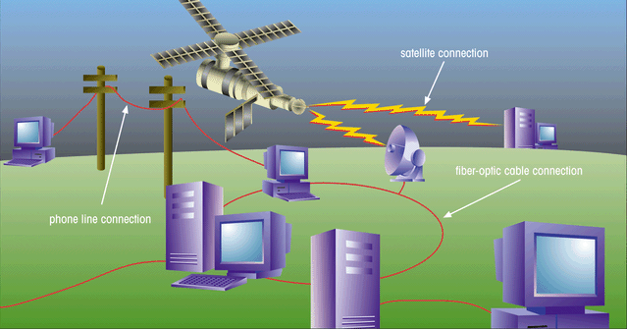
Structure of the Internet
This figure shows the physical structure of the Internet, which uses fiber-optic cables, satellites, phone lines, and other telecommunications media to send data back and forth.
PRELIM

Slide 60
The Development of the
World Wide Web
In 1989, Timothy Berners-Lee and other researchers at the CERN nuclear research facility, laid the foundation of the World Wide Web, or the Web.
  created an information system that would make it easy for researchers to locate and share data
  required minimal training and support
  developed a system of hypertext documents, electronic files that contain elements that you can easily select
PRELIM

Slide 61
Hypertext Documents
Hypertext offers a better way of locating information.
When you read a book, you follow a linear progression, reading one page after another.
With hypertext, you progress through pages in whatever way is best suited to you and your objectives.
Hypertext lets you skip from one topic to another.
PRELIM

Slide 62
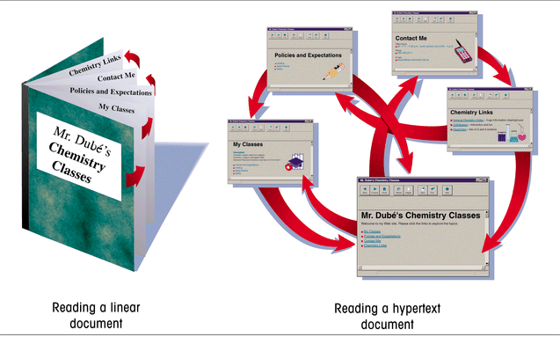
Linear Versus Hypertext Documents
This figure shows how topics can be related in a hypertext fashion,as opposed to a linear fashion.
PRELIM

Slide 63
Hypertext Documents Continued
The key to hypertext is the use of links, which you activate to move from one topic to another.
  a link can open a document on a computer anywhere in the world
Hypertext has become the dominate method of sharing and retrieving information on the Internet, becoming known as the World Wide Web, or the Web.
Documents on the Web are known as Web pages.
PRELIM

Slide 64
Web Pages and Web Browsers
A Web page is stored on a Web server, which makes the page available to users of the Web.
To view a Web page, the user runs a Web browser, a software program that retrieves the page and displays it.
A Web browser can either be text-based, or graphical.
PRELIM

Slide 65
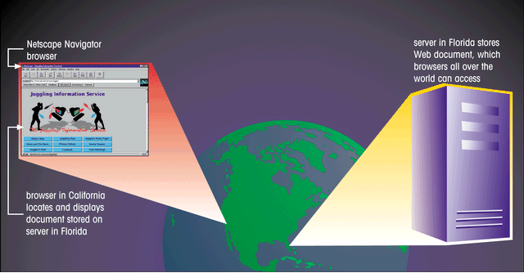
Using a Browser to View a Web Document on a Server
This figure shows to view web pages, the user runs a Web browser,
a software program that retrieves the page and displays it.
PRELIM

Slide 66
Internet Explorer and Netscape
The most common Web browsers available today are:
  Microsoft Internet Explorer
  Netscape Navigator
  Mozilla Firefox
PRELIM

Slide 67

Web Page with Interesting Fonts, Graphics, and Layout
This figure shows a Web page is not only a source of information, it can also be a work of art.
graphic image
links
interesting fonts
The Web designer has a great deal of control over the format of the page.
PRELIM

Slide 68
HTML: The Language of the Web
Web pages are text files, written in a language called Hypertext Markup Language or HTML.
A markup language is a language used to describe the contact and format of documents.
HTML was developed from the Standard Generalized Markup Language (SGML), a language used for large-scale documents.
SGML proved to be cumbersome and difficult, thus HTML was created.
PRELIM

Slide 69
Hypertext Markup Language (HTML)
HTML allows Web authors to create documents that can be displayed across different operating systems.
HTML code is easy to use, that even nonprogrammers can learn to use it.
HTML describes the format of Web pages through the use of tags.
  it’s the job of the Web browser to interpret these tags and render the text accordingly
PRELIM

Slide 70
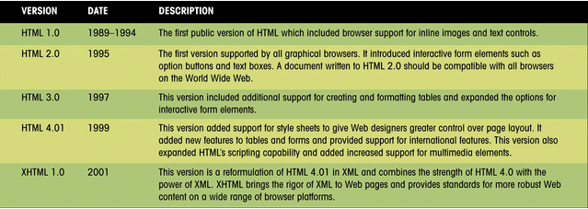
Versions of HTML
This figure presents a history of the various versions of HTML that have been released by the World Wide Web Consortium (W3C).
PRELIM

Slide 71
Hypertext Markup
Language (HTML) Continued
HTML has a set of rules, called syntax.
  syntax are a set of standards or specifications developed by a consortium of Web developers, programmers, and authors called the World Wide Web Consortium (WC3)
HTML extensions have been added to support new features, which have been adopted in subsequent sets of standards released by the W3C.
  these extensions have provided Web page authors with more options
PRELIM

Slide 72
Web Development
Web designers need to determine which browsers and browser versions support their web pages.
In the future, Web development is focusing more on XML (Extensible Markup Language) and XHTML (Extensible HyperText Markup Language) for developing document content.
PRELIM

Slide 73
Tools for Creating HTML Documents
HTML documents are text files, which a text editor such as Windows NotePad can be used to create.
You can also use an HTML converter or an HTML editor.
  an HTML converter like Microsoft Word takes text in one format and converts it to HTML code
  an HTML editor helps you create an HTML file by inserting HTML codes for you as you work
PRELIM

Slide 74

Creating an HTML Document
It’s always a good idea to plan the appearance of your Web page before you start writing code.
heading 1
image
horizontal line
paragraph
list
heading 3
bold and italic text
PRELIM

Slide 75
HTML Syntax
Document content is what the users sees on the page, such as headings and images.
Tags are the HTML codes that control the appearance of the document content.
  tag is the name of the HTML tag
  attributes are properties of the tag
  document content is actual content that appears in the Web page
PRELIM

Slide 76
HTML Tags
Tags can be one-sided or two-sided.
  two-sided tags contain an opening tag <b> that tells the browser to turn on a feature and apply it to the contact that follows, and a closing tag </b> that turns off the feature
  one-sided tags are used to insert noncharacter data into the Web page, such as a graphic image or video clip <tag attribute>
Tags are not case sensitive. The current standard is to display all tags in lowercase letters.
PRELIM

Slide 77
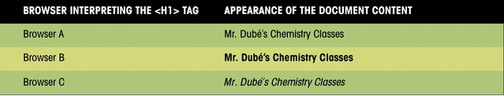
Interpretation of the <H1> tag by Different Browsers
This figure shows how three different browsers might interpret a line of HTML code.
PRELIM

Slide 78
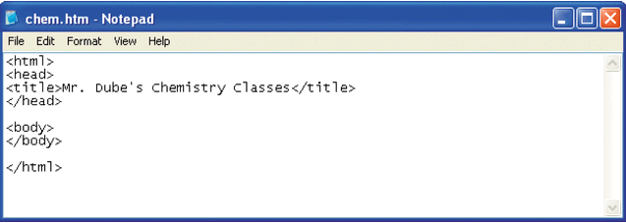
Initial HTML Tags in Notepad
Your text editor may not display the file extension in the title bar. This is okay.
<html> tag indicates that this file is written in HTML
<title> tag contains
the Web page title
Page content will
go between the
<body> tags
<head> tag contains information about the Web page
PRELIM

Slide 79
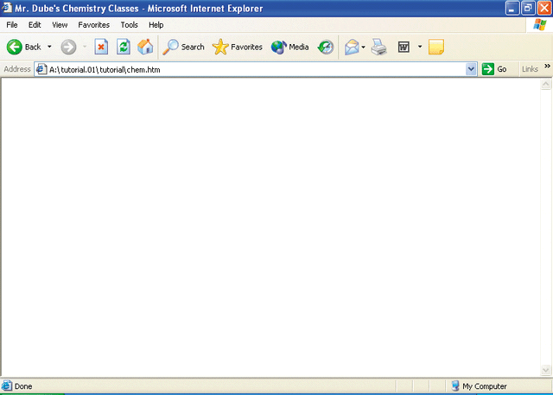
The Initial HTML File in
Internet Explorer
the title you entered between the <title> tags
address box indicates the name and location of the HTML file
You should occasionally view the formatted page with different Web browsers to check compatibility, verify that there are no syntax errors, or other problems.
page content will appear here
PRELIM

Slide 80
Creating Heading Tags
HTML supports six levels of headings, numbered <h1> through <h6>, with <h1> being the largest and most prominent.
Headings are always displayed in a bold font.
PRELIM

Slide 81
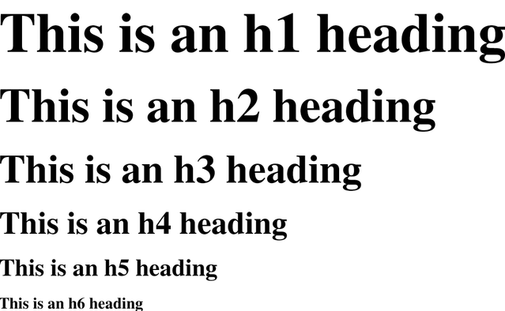
Six Heading Levels
This figure illustrates the general appearance of the six heading styles. Your browser might use slightly different fonts and sizes.
PRELIM

Slide 82
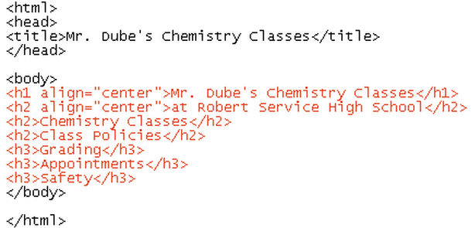
Entering Heading Tags and Text
heading tags
As of HTML 3.2, the heading tag can contain additional attributes, one of which is the alignment attribute.
PRELIM

Slide 83
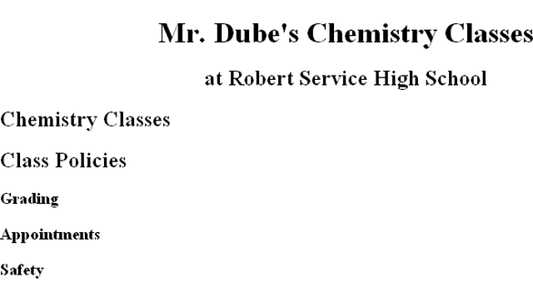
Headings As They Appear in the Browser
<h1>
<h2>
<h3>
PRELIM

Slide 84
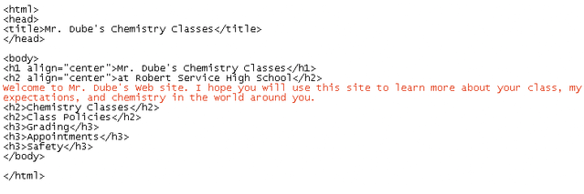
Entering Paragraph Text
If you are using a test editor like NotePad, the text might not wrap to the next line automatically.
Selecting the Word Wrap command within NotePad will allow you to see all the text on your screen.
PRELIM

Slide 85
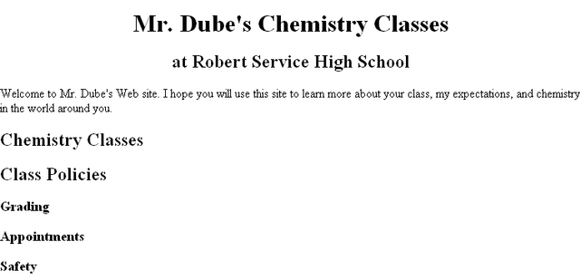
Paragraph Text in the Browser
PRELIM

Slide 86
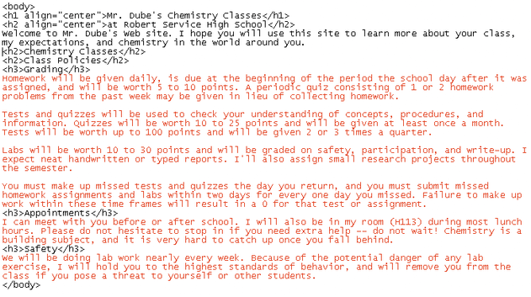
Adding Paragraphs
adding
paragraphs
PRELIM

Slide 87
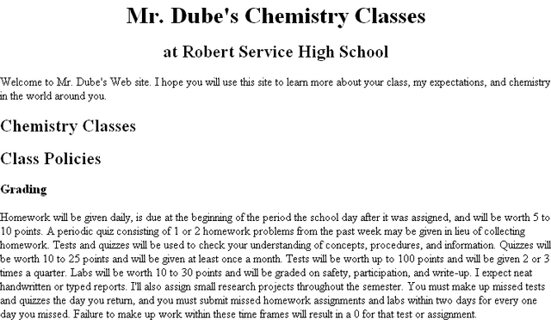
The Paragraphs Displayed by the Browser
Remember: HTML formats text only through the use of tags and ignores such things as extra blank spaces, blank lines, or tabs.
four grading
paragraphs are not
separated
PRELIM

Slide 88
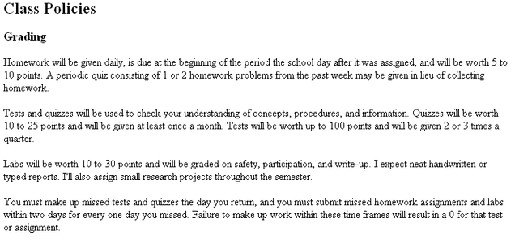
The Grading Text Separated into Paragraphs
To add space between paragraphs, you use the paragraph tag <p>.
text is now separated into four paragraphs
PRELIM

Slide 89
Creating Lists
HTML supports three kinds of lists:
  an ordered list, which is used to display information in a numeric order
  an unordered list, which list items are not listed in a particular order i.e. bullets
  a definition list, which is a list of terms, each followed by a definition line that is typically indented slightly to the right
PRELIM

Slide 90
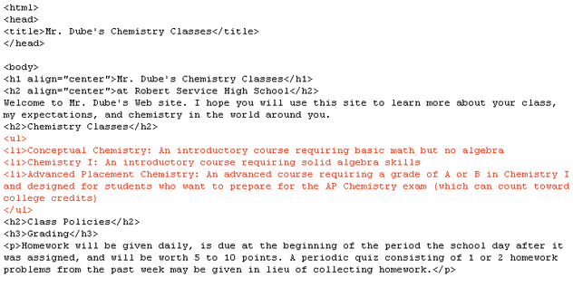
Entering an Unordered List
<ul> unordered
list tag
<li> list item tag
PRELIM

Slide 91
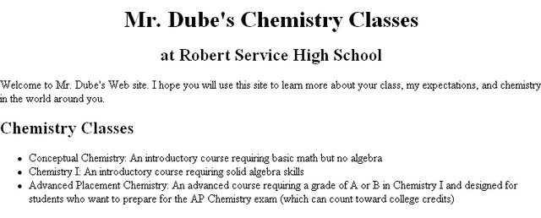
The Unordered List in the Browser
An unordered list is a bulleted list.
unordered
list
PRELIM

Slide 92
Creating Character Tags
HTML also lets you format individual characters.
A tag that you apply to an individual character is called a character tag. There are two types of character tags:
  logical character tag
  physical character tag
PRELIM

Slide 93
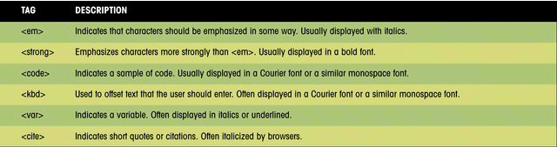
Common Logical Character Tags
This figure lists some common logical character tags.
PRELIM

Slide 94
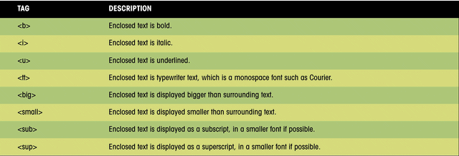
Common Physical Character Tags
This figure shows examples of how these tags can be displayed in a browser.
PRELIM

Slide 95
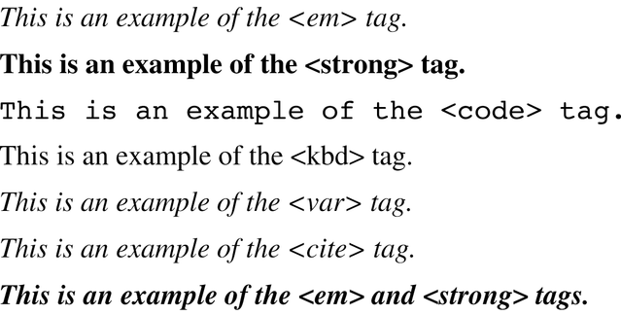
Logical Character Tags as They Appear in the Browser
examples of individual tags
example of combined tags
PRELIM

Slide 96
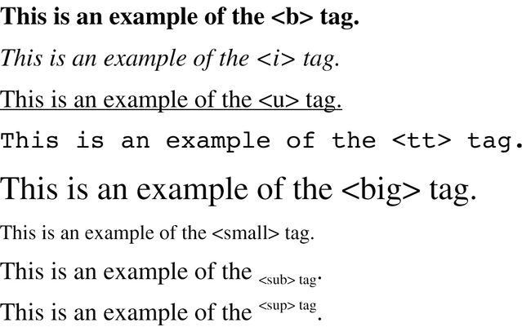
Physical Character Tags as They Appear in the Browser
Underline text can sometimes be confused with hyperlinked text (which is usually underlined), and for that reason, use of the <u> tag is discouraged.
PRELIM

Slide 97
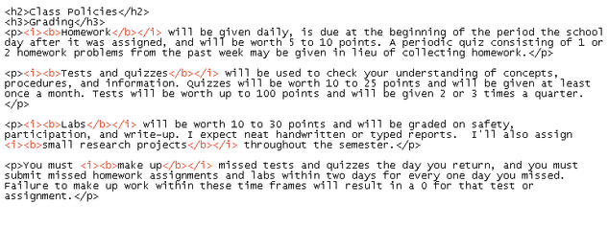
Applying Character Tags
Italic <i> </i>
and bold
<b> </b>
character tags
If you support users with older browsers, you should use a logical tag. Otherwise, use physical tags, which are more common and easier to interpret.
PRELIM

Slide 98
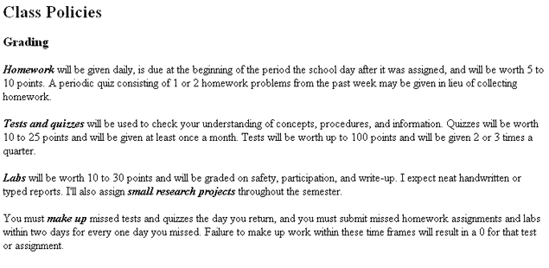
The Effect of the Character Tags in the Browser
text formatted with bold and italic
PRELIM

Slide 99
Inserting a Graphic
Images can be displayed in two ways: as inline images or as external images.
  an inline image displays directly on the Web page and is displayed when the page is accessed by a user
  an inline image can be placed on a separate line in your HTML code, or it can be placed directly within a line of text
  inline images should be in one of two file formats: GIF (Graphics Interchange Format) or JPEG (Joint Photographic Experts Group)
PRELIM

Slide 100
Inserting a Graphic Continued
  an external image is not displayed with the Web page, the browser must have a file viewer, which is a separate program that the browser launches when it encounters an external image file
  external images are represented by an icon that a user clicks to view the image
  external images are not limited to GIF or JPEG formats
PRELIM

Slide 101

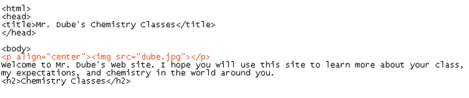
Inserting a Graphic
Image file
dube.jpg
use the <p> tag so you can center the image
PRELIM

Slide 102

The Image File as it Appears in the Browser
PRELIM

Slide 103
Special Characters
Occasionally you will want to include entities or special characters in your Web page that do not appear on your keyboard. For example:
  registered trademark symbol ®
  copyright symbol ©
HTML supports the use of character symbols that are identified by a code number or name.
PRELIM

Slide 104
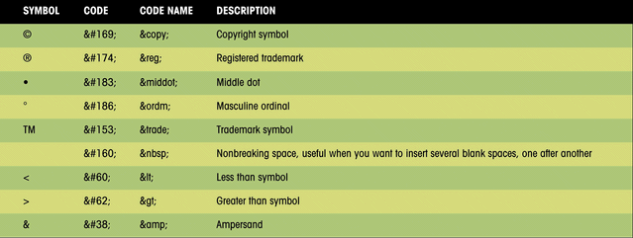
Special Characters and Codes
This figure shows some HTML symbols and the corresponding code numbers or names.
PRELIM

Slide 105

Special Characters in the Browser
This figure shows an example of the code “Welcome to Mr. Dub&#233’s
Web site”, which accented the é in his last name..
accented é added
to last name
PRELIM

Slide 106
Inserting Horizontal Lines
A horizontal line can improve the appearance of a Web page.
The syntax for creating a horizontal line is:
  <hr align=“align” size=“size” width=“width” color=“color” noshade>
PRELIM

Slide 107
Inserting Horizontal Lines
The HTML horizontal syntax includes the following:
  align specifies the horizontal alignment of the line on the page (center, left, or right)
  size specifies the height of the line in pixels or percentage of the screen width
  width indicates the width of the line in pixels or percentage of the screen width
  color indicates the color of the line
  noshade specifies that the browser display a solid line
PRELIM

Slide 108
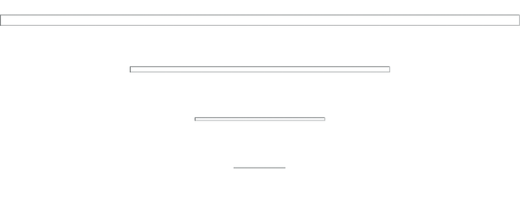
Different Line Styles
size=12
width-100%
<hr align=“center” size=“12” width=“100%”>
<hr align=“center” size=“6” width=“50%”>
size=6
width-50%
<hr align=“center” size=“3” width=“25%”>
size=3
width-25%
size=1
width-10%
<hr align=“center” size=“1” width=“10%”>
You can use line styles to improve the appearance of your Web page.
PRELIM

Slide 109
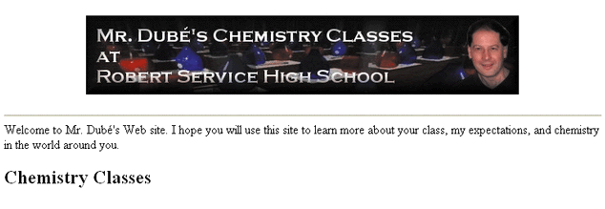
Horizontal Line Added to the Page
horizontal line
PRELIM

Slide 110
Unit 1 Summary
Learned about the history and structure of the World Wide Web.
Introduced the basic principles of Web documents and about the HTML language.
Learned how to create a Web page using basic layout tags.
Learned how to create paragraphs, headings and lists (both ordered and unordered).
Worked with character tags and special characters.
Introduced to working with graphics by creating a horizontal line and an inline graphic image.
PRELIM

Slide 111
Introduction to HTML 2

Slide 112
Defining an HTML Table
An HTML table is defined with the <table> tag.
Each table row is defined with the <tr> tag.
A table header is defined with the <th> tag.
By default, table headings are bold and centered.
A table data/cell is defined with the <td> tag.

Slide 113
Example 1
<table style="width:100%">
<tr>
<th>Firstname</th>
<th>Lastname</th>
<th>Age</th>
</tr>
<tr>
<td>Jill</td>
<td>Smith</td>
<td>50</td>
</tr>
<tr>
<td>Eve</td>
<td>Jackson</td>
<td>94</td>
</tr>
</table>
Note: The <td> elements are the data containers of the table.
They can contain all sorts of HTML elements; text, images, lists, other tables, etc.

Slide 114
HTML Table - Adding a Border
If you do not specify a border for the table, it will be displayed without borders.
A border is set using the CSS border property:

Slide 115
Remember to define borders for both the table and the table cells.
Remember to define borders for both the table and the table cells.
Example
table, th, td {
border: 1px solid black;
Remember to define borders for both the table and the table cells.

Slide 116
HTML Table - Collapsed Borders
If you want the borders to collapse into one border, add the CSS border-collapse property:
Example
table, th, td {
border: 1px solid black;
border-collapse: collapse;
}

Slide 117
HTML Table - Adding Cell Padding
Cell padding specifies the space between the cell content and its borders.
If you do not specify a padding, the table cells will be displayed without padding.

Slide 118
Example 5
To set the padding, use the CSS padding property:
Example
th, td {
padding: 15px;
}

Slide 119
HTML Table - Left-align Headings
By default, table headings are bold and centered.
To left-align the table headings, use the CSS text-align property:

Slide 120
HTML Table - Left-align Headings
Example
th {
text-align: left;
}

Slide 121
HTML Table - Adding Border Spacing
Border spacing specifies the space between the cells.
To set the border spacing for a table, use the CSS border-spacing property:

Slide 122
HTML Table - Adding Border Spacing
Example
table {
border-spacing: 5px;
}
Note: If the table has collapsed borders, border-spacing has no effect.

Slide 123
HTML Table - Cells that Span Many Columns
To make a cell span more than one column, use the colspan attribute:
<table style="width:100%">
<tr>
<th>Name</th>
<th colspan="2">Telephone</th>
</tr>
<tr>
<td>Bill Gates</td>
<td>55577854</td>
<td>55577855</td>
</tr>
</table>

Slide 124
HTML Table - Cells that Span Many Rows
<table style="width:100%">
<tr>
<th>Name:</th>
<td>Bill Gates</td>
</tr>
<tr>
<th rowspan="2">Telephone:</th>
<td>55577854</td>
</tr>
<tr>
<td>55577855</td>
</tr>
</table>
To make a cell span more than one row, use the rowspan attribute:

Slide 125
HTML Styles – CSS Example
<html>
<head>
<style>
body {background-color:lightgrey}
h1 {color:blue}
p {color:green}
</style>
</head>
<body>
<h1>This is a heading</h1>
<p>This is a paragraph.</p>
</body>
</html>

Slide 126
HTML Styles - CSS
CSS styling can be added to HTML elements the following 3 ways:
Inline - using the style attribute in HTML elements
Internal - using the <style> element in the <head> section
External - using external CSS files

Slide 127
Inline Styles
Inline styling is useful for applying a unique style to a single HTML element:
Inline styling uses the style attribute.
This line styling changes the text color and the left margin of single paragraph

Slide 128
Example: Inline
<html>
<body>
<h1 style="color:blue">This is a heading</h1>
<p style="color:green;margin-left:20px">This is a paragraph.</p>
</body>
</html>

Slide 129
CSS Background Color
The CSS style background-color defines the background color for an HTML element

Slide 130
CSS Background Color Example
<html>
<body style="background-color:lightgrey">
<h1 style="color:blue">This is a heading</h1>
<p style="color:green;margin-left:20px">This is a paragraph.</p>
</body>
</html>

Slide 131
CSS Font Family
<html>
<body>
<h1 style="font-family:verdana">This is a heading</h1>
<p style="font-family:courier">This is a paragraph.</p>
</body>
</html>

Slide 132
CSS Font Size
<html>
<body>
<h1 style="font-size:300%">This is a heading</h1>
<p style="font-size:160%">This is a paragraph.</p>
</body>
</html>

Slide 133
CSS Font Color
<html>
<body>
<h1 style="color:blue">This is a heading</h1>
<p style="color:red">This is a paragraph.</p>
</body>
</html>

Slide 134
CSS Text Alignment
<html>
<body>
<h1 style="text-align:center">Center-aligned heading</h1>
<p>This is a paragraph.</p>
</body>
</html>

Slide 135
Internal CSS
An internal style sheet can be used to define a common style for all HTML elements on a page.
Internal styles are defined in the <head> section of an HTML page, in the <style> element

Slide 136
<html>
<head>
<style>
body {background-color:lightgrey}
h1 {color:blue}
p {color:green}
</style>
</head>
<body>
<h1>This is a heading</h1>
<p>This is a paragraph.</p>
</body>
</html>

Slide 137
External CSS
External style sheet are ideal when the style is applied to many pages.
With external style sheets, you can change the look of an entire site by changing one file.
External styles are defined in the <head> section of an HTML page, in the <link> element

Slide 138
<html>
<head>
<link rel="stylesheet" href="styles.css">
</head>
<body>
<h1>I am formatted with an external style sheet</h1>
<p>Me too!</p>
</body>
</html>

Slide 139
HTML Style Tags
Tag | Description
<style> | Defines style information for a document
<link> | Defines the relationship between a document and an external resource

Slide 140
HTML exercises
http://www.landofcode.com/html-exercises/

